Slide 1

Introduction to Database Management System (DBMS)
Presented By: Ashmi.P.S

Slide 2
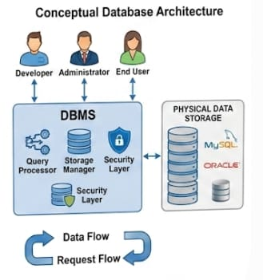
Definition of DBMS
What is DBMS?
DBMS stands for Database Management System.
It is software used to create, store, manage, and retrieve data.
It acts as an interface between users and the database.
It provides secure and organized data storage.
Examples: MySQL, Oracle, SQL Server, PostgreSQL.
Why DBMS is Needed?
To manage large amounts of data.
To reduce duplicate data.
To improve data security.
To provide faster data access.
To support multiple users simultaneously.

Slide 3
Objectives and Features of DBMS
Objectives
Reduce data redundancy.
Maintain data consistency.
Ensure data integrity.
Provide data security.
Support concurrent user access.
Improve data sharing.
Provide backup and recovery.
Increase database performance.
Features
Data Independence
Data Security
Data Integrity
Transaction Management
Concurrency Control
Backup & Recovery
Multiple User Access
Query Processing

Slide 4
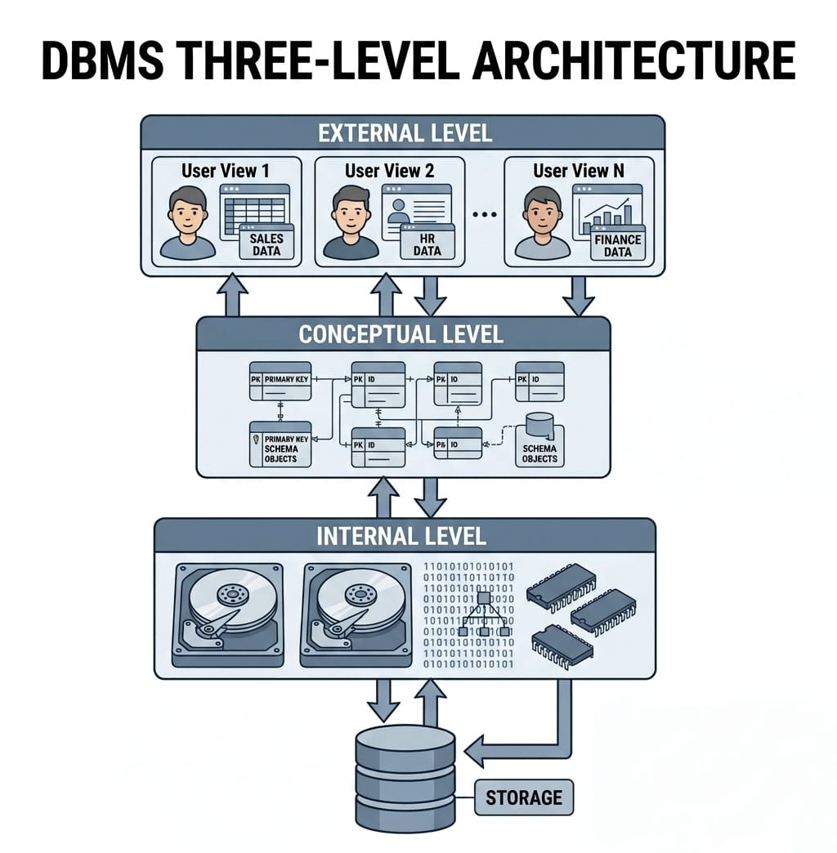
Components of DBMS
Database
DBMS Software
Users
Database Administrator (DBA)
Application Programs
SQL (Structured Query Language)

Slide 5
Advantages & Applications of DBMS
Advantages
Applications
Fast data access.
Improved security.
Backup and recovery.
Easy data management.
Supports multiple users.
Reduces data duplication.
Banking Systems.
Hospitals.
Colleges & Universities.
E-commerce Websites.
Airline Reservation Systems.
Social Media Platforms

Slide 6
THANK YOU

